Slide 1
Tech Literacy/Job Training
Christopher Schilling and Sam Walker

Slide 2
Skills Required for Tech Literacy
According to the International Society for Technology in Education, tech literacy requires users to exhibit skills such as:
Creativity and Innovation
Use technology to demonstrate creative thinking, problem solving, and knowledge construction.
Communication and Collaboration
Use technology to communicate and collaborate to enhance problem solving.
Research and Information Fluency
Use technology to find and use accurate, up-to-date information.
Digital Citizenship
Understand what it means to be an ethical citizen in the digital world.
Technology Operations and Concepts
Illustrate an understanding of technological systems and concepts.

Slide 3
OECD Study
Organization for Economic Cooperation and Development
Conducted from 2011-2015
Over 215,000 Participants
From 33 “rich” countries
Aged 16-65, working age
Participants were asked to perform 14 computer-based tasks
Easy tasks such as the reply-all feature for email.
Difficult tasks such as scheduling a meeting room in a scheduling application using information from several emails.

Slide 4
Levels of Tech Proficiency
Below Level 1: 14% of Adult Population
Level 1: 29% of Adult Population
>1
1
The use of only one function within a generic interface to meet one explicit criterion.
Ex. “Delete this email message” in an email program.
Multi-step tasks that use familiar applications, such as email software or a web browser.
Ex. “Find all emails from John Smith.”
Level 2: 26% of Adult Population
Level 3: 5% of Adult Population
2
3
The use of tools (e.g. a sort function) that can facilitate the resolution of a problem.
Ex. “You want to find a sustainability-related document that was sent to you by John Smith in October last year,
Tasks that require both generic and more specific technology applications.
Schedule a meeting room in a scheduling application, using info contained in several emails.

Slide 5
26% of the Adult Population never attempted the tasks because they are unable to use a computer.

Slide 6
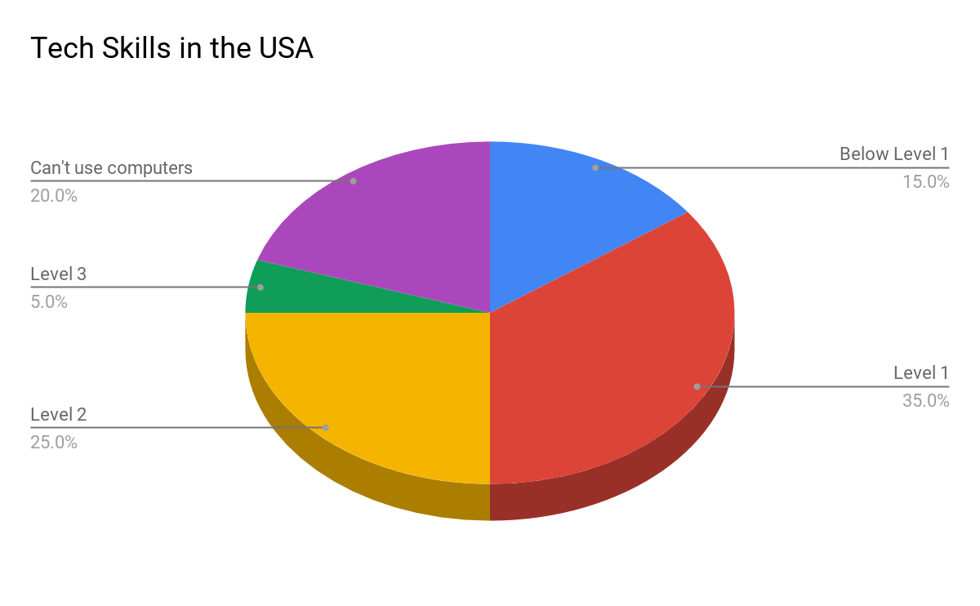
Proficiency in America

Slide 7
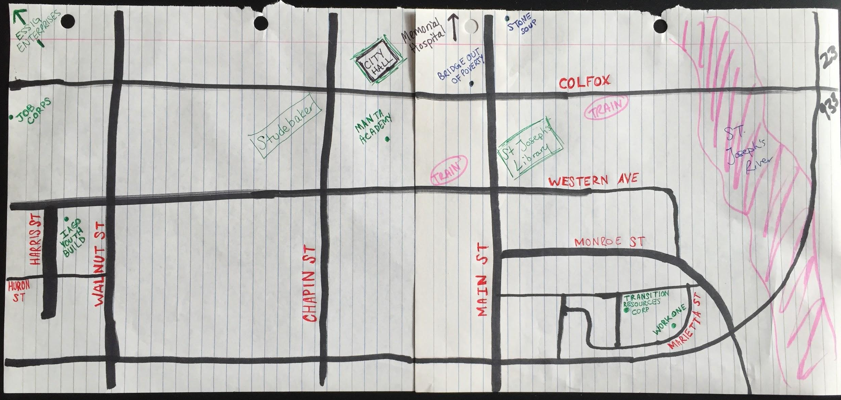

Slide 8
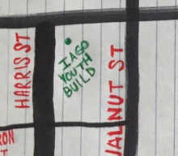





Work Development Resources
Work One
Essig Enterprises
Job Corps
Iago Youth Build
Transition Resources Corp
Manta Academy

Slide 9

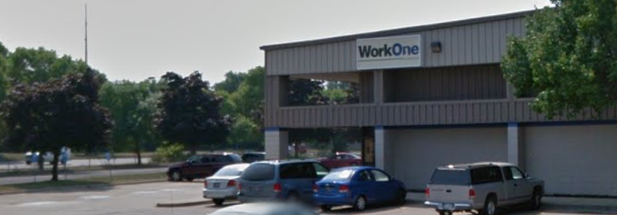
American Job Center through Workforce Innovation and Opportunity Act
Training for Northern Indiana employer needs (math, writing and computer skills, soft skills)
Sector partnerships/career pathways
Removes employer-identified skills gaps
Meets local employers needs
310,000 workers and job seekers in this region

Slide 10

Phone number is to South Bend WorkOne
For small existing businesses to grow internally
The “courses” are online videos (~5-10 minutes long)
Personal learning rather than certified training

Slide 12


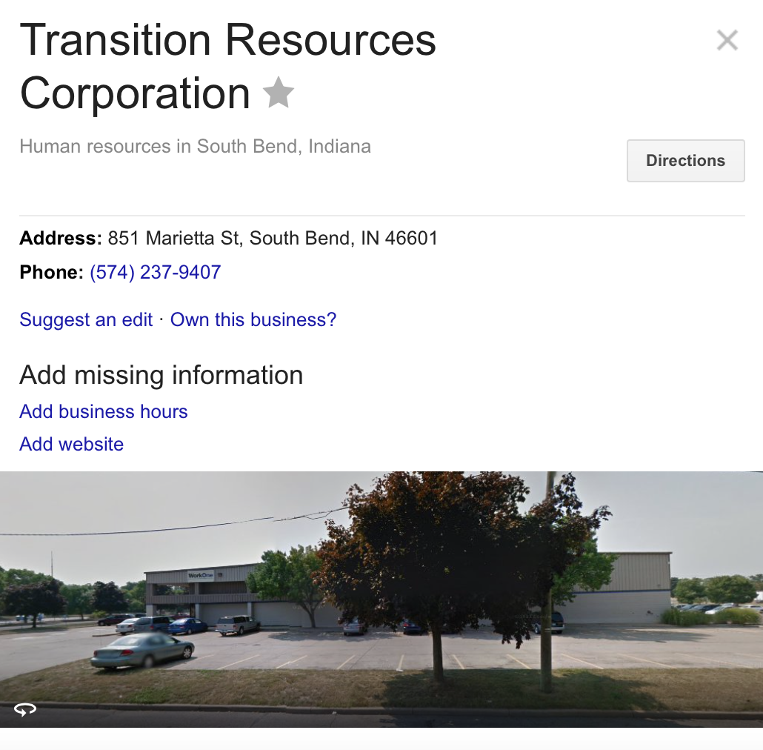

Slide 13

Transition Resources Group
No website Call for Info Invalid #
Frustration

Slide 14


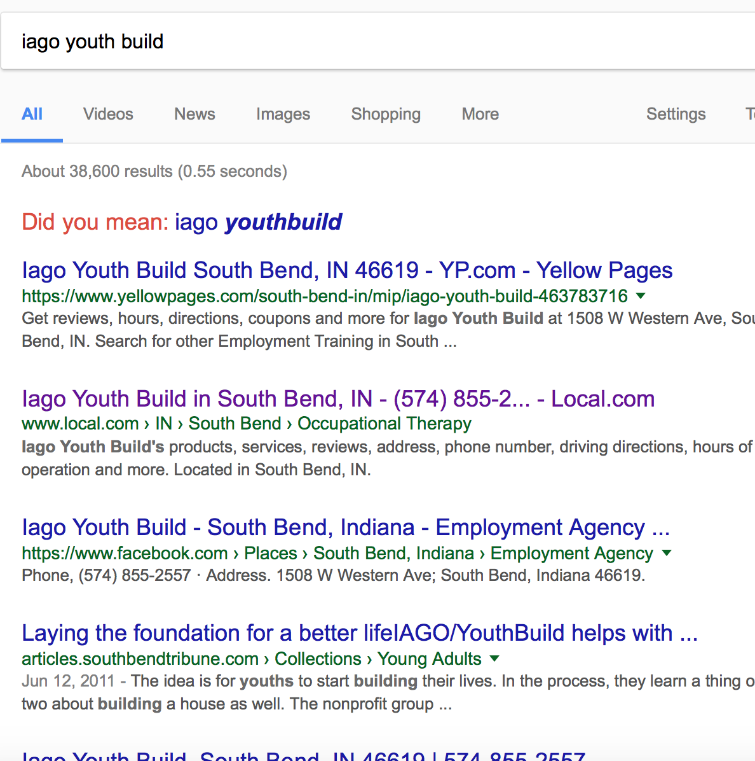

Slide 15
Iago Youth Build
No website Call for Info Invalid #
More Frustration

Slide 16




Slide 17

Essig Enterprises Training Program
Had a website
Not clear on who could train here
Call for Info Voicemail full
Even More Frustration

Slide 18




Slide 19
Job Corps
Got a Call Back!
They work with Dept of Labor
Free to low income families who meet criteria
Ages 16-24 y/o
Finish high school + training
Live-on campus not in South Bend
Training in culinary arts, computer technician, auto industry, construction trade (electric, plumbing, painting etc)

Slide 20

Emergency Help Resources
Stone Soup
Currently closed- restructuring
Crisis Intervention (financial)
Pay bills- need $100 now
Self sufficiency training
Mentoring
Budget counseling
Resume writing
Bridge Out of Poverty
Free classes for underresourced
50 hr “Getting Ahead” class
Financial management class
Employer/employee program to improve retention and stabilize the workplace
Professional development workshops for entire community
Paid consulting work with companies
Working to move people out of poverty
3 lenses of poverty
Individual
Institutional
Community (policies/infrastructure)

Slide 21
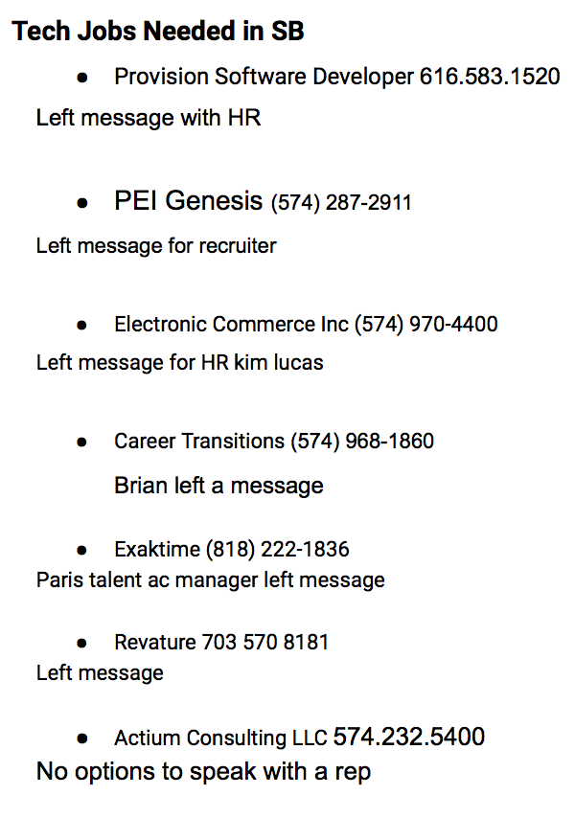
South Bend Tech
Provision Software Developer
PEI Genesis
Electronic Commerce Inc
Career Transitions
ExakTime
Revature
Actium Consulting LLC

